Slide 1


Network protocols & security
24EC2210
Topic:
UDP & TCP Protocols
Session - 25

Slide 2
UDP – User Datagram Protocol

Slide 3
User Datagram Protocol (UDP)
The User Datagram Protocol (UDP) is called a connectionless, unreliable transport protocol.
It does not add anything to the services of IP except to provide process-to-process communication instead of host-to-host communication.

Slide 4
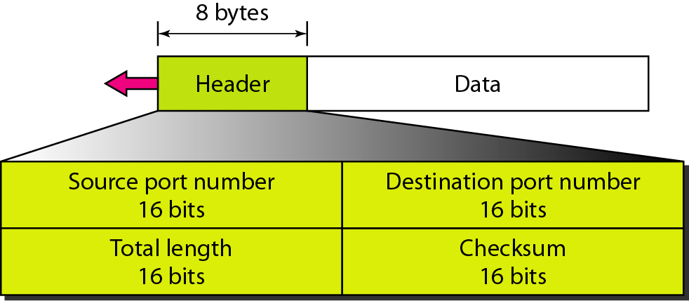
UDP Format
UDP header is an 8-byte fixed and simple header.

Slide 5
UDP Format…
Source Port: Source Port is a 2 Byte long field used to identify the port number of the source.
Destination Port: It is a 2 Byte long field, used to identify the port of the destined packet.
Length: Length is the length of UDP including the header and the data. It is a 16-bits field.
Checksum: Checksum is 2 Bytes long field. Checksum is computed on the UDP header, the pseudo-header from the IP header, and the data, padded with zero octets at the end (if necessary) to make a multiple of two octets.

Slide 6
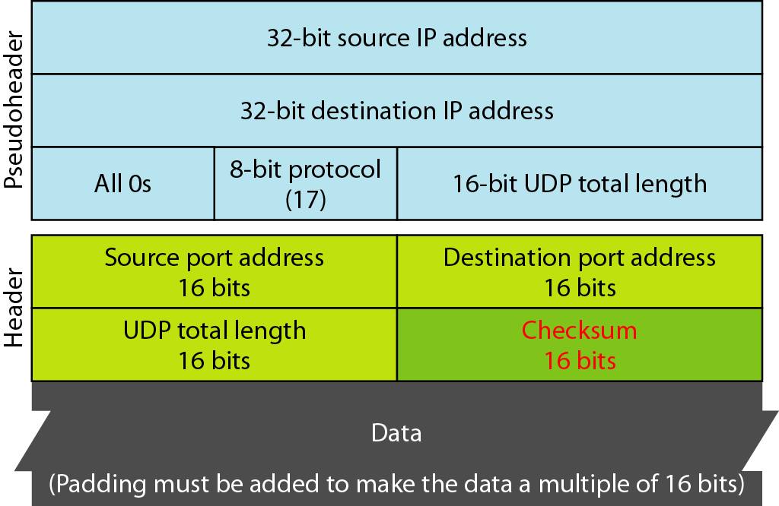
Pseudoheader for checksum calculation

Slide 7
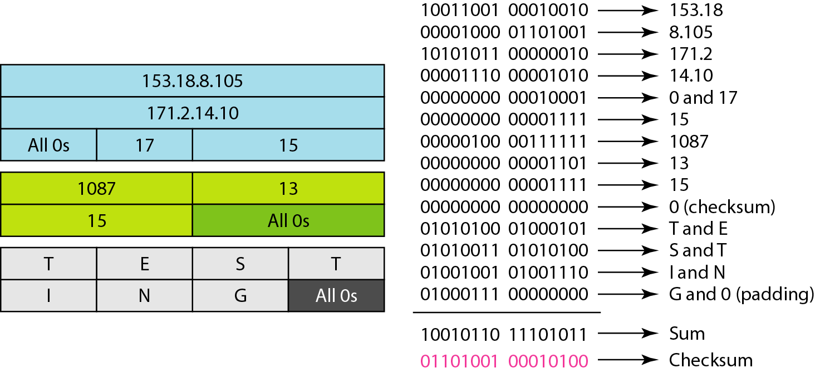
Example: Checksum calculation

Slide 8
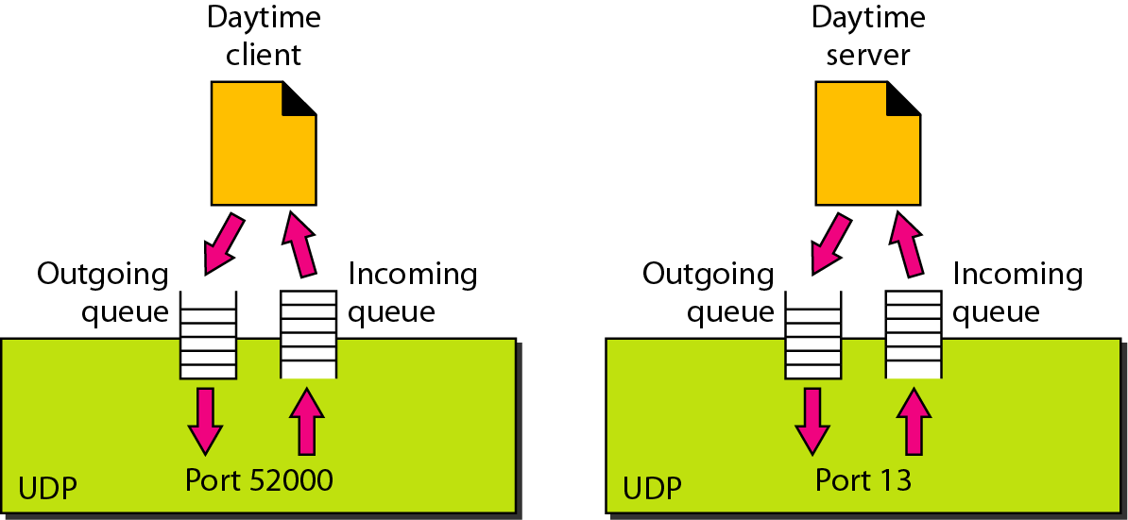
Figure 23.12 Queues in UDP

Slide 9
Uses of UDP
UDP is suitable for a process that requires simple request-response communication with little concern for flow and error control.
UDP is suitable for a process with internal flow and error control mechanisms. UDP is used for the Trivial File Transfer Protocol (TFTP) process includes flow and error control.
UDP is a suitable for multicasting. Multicasting capability is embedded in the UDP software but not in the TCP software.
UDP is used for management processes such as SNMP..
UDP is used for some route updating protocols such as Routing Information Protocol (RIP).

Slide 10
TCP – Transmission Control Protocol

Slide 11
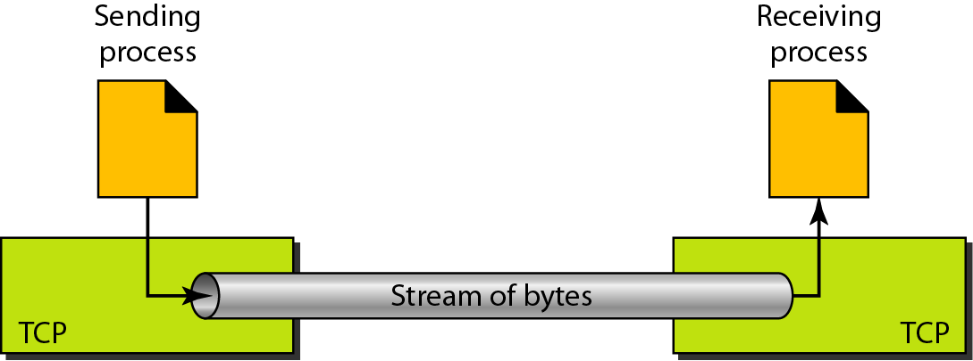
TCP – Transport Control Protocol
TCP is a connection-oriented protocol.
It creates a virtual connection between two TCPs to send data.
In addition, TCP uses flow and error control mechanisms at the transport level.
The bytes of data being transferred in each connection are numbered by TCP.

Slide 12
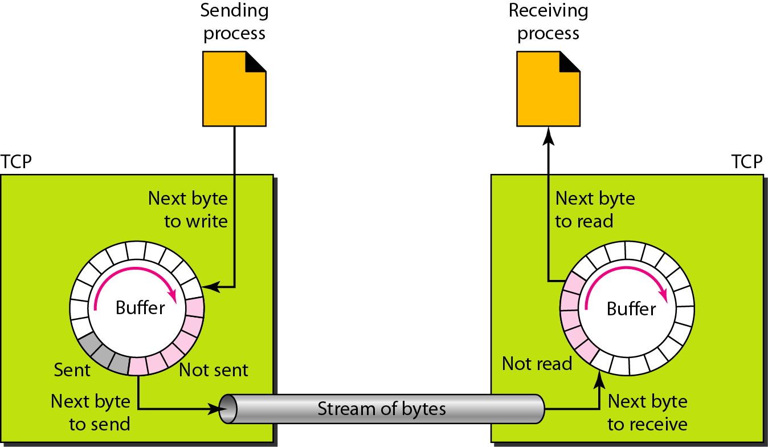
Figure 23.14 Sending and receiving buffers

Slide 13
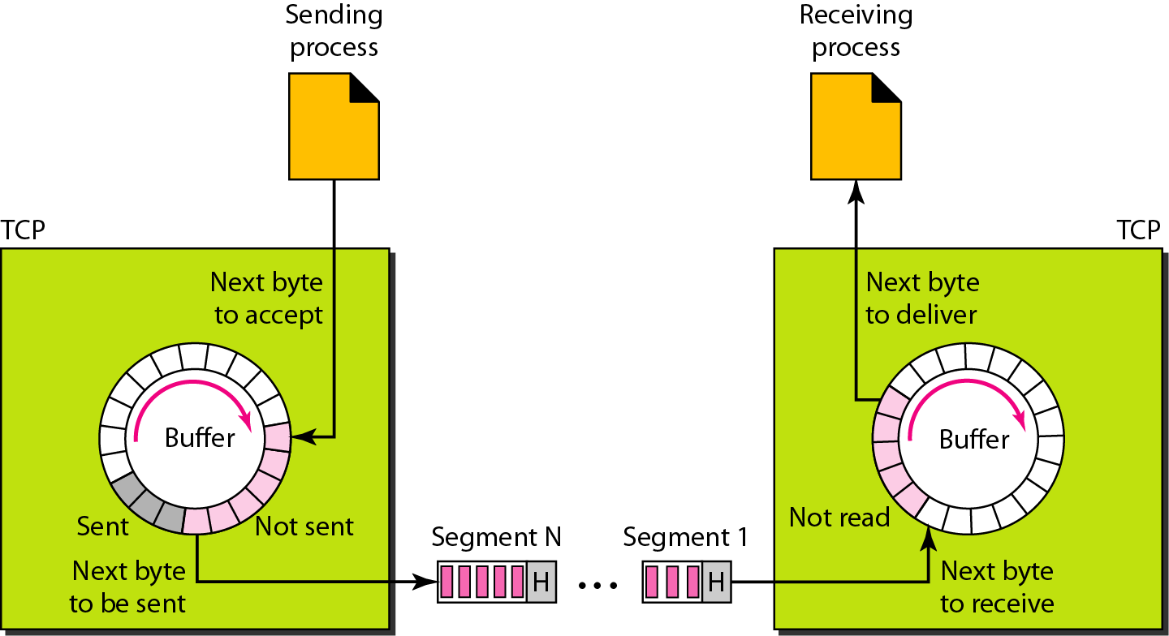
Figure 23.15 TCP segments

Slide 14

Note
The bytes of data being transferred in each connection are numbered by TCP.
The numbering starts with a randomly generated number.

Slide 15
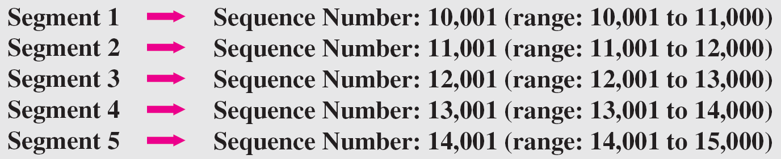
Example 23.3
The following shows the sequence number for each segment:

Slide 16
Note
The value in the sequence number field of a segment defines the
number of the first data byte contained in that segment.

Slide 17
Note
The value of the acknowledgment field in a segment defines
the number of the next byte a party expects to receive.
The acknowledgment number is cumulative.

Slide 18
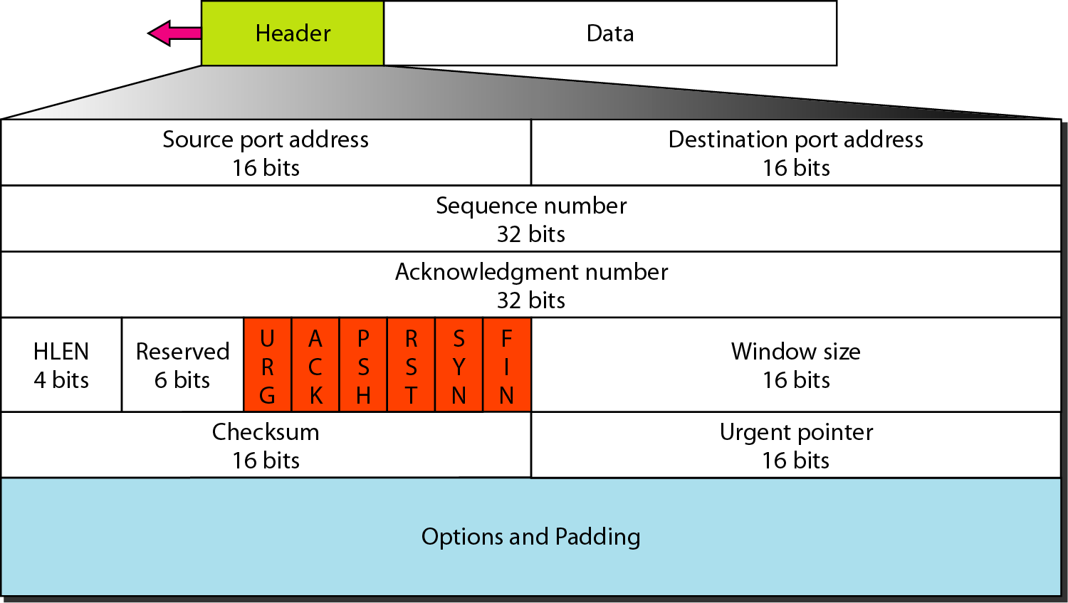
TCP Segment Header

Slide 19
TCP Segment Header…
Source port: 16-bit field. It defines the port of the application, which is sending the data.
Destination port: 16-bit field. It defines the port of the application on the receiving side.
Sequence number: This field contains the sequence number of first data byte in a particular segment.
Acknowledgment number: The field in a segment defines the number of the next byte that receiver expects to receive.
HLEN: It specifies the length of the header indicated by the 4-byte words in the header. The size of the header lies between 20 and 60 bytes. Therefore, the value of this field would lie between 5 and 15.
Reserved: It is a 4-bit field reserved for future use, and by default, all are set to zero.

Slide 20
TCP Segment Header…
Flags: There are six control bits or flags.
URG: It represents an urgent pointer. If it is set, then the data is processed urgently.
ACK: If the ACK is set to 0, then it means that the data packet does not contain an acknowledgment.
PSH: If this field is set, then it requests the receiving device to push the data to the receiving application without buffering it.
RST: If it is set, then it requests to restart a connection.
SYN: It is used to establish a connection between the hosts.
FIN: It is used to release a connection, and no further data exchange will happen.

Slide 21
TCP Segment Header…
Window size: 16-bit field. It contains the size of data that the receiver can accept. This field is used for the flow control and the value of this field is determined by the receiver.
Checksum: 16-bit field. This field is optional in UDP, but in the case of TCP/IP, this field is mandatory.
Urgent pointer: Pointer that points to the urgent data byte if the URG flag is set to 1.
Options: 32-bit field for additional options. If this field contains the data less than 32-bit, then padding is required to obtain the remaining bits.

Slide 22
Difference between TCP and UDP
Basis | Transmission Control Protocol (TCP) | User Datagram Protocol (UDP)
Type of Service | TCP is a connection-oriented protocol. | UDP is the Datagram-oriented protocol.
Reliability | TCP is reliable as it guarantees the delivery of data to the destination router. | The delivery of data to the destination cannot be guaranteed in UDP.
Error checking mechanism | TCP provides extensive error-checking mechanisms. It is because it provides flow control and acknowledgment of data. | UDP has only the basic error-checking mechanism using checksums.
Acknowledgment | An acknowledgment segment is present. | No acknowledgment segment.
Sequence | Sequencing of data is a feature of Transmission Control Protocol (TCP). This means that packets arrive in order at the receiver. | There is no sequencing of data in UDP. If the order is required, it has to be managed by the application layer.
Speed | TCP is comparatively slower than UDP. | UDP is faster, simpler, and more efficient than TCP.
Retransmission | Retransmission of lost packets is possible in TCP, but not in UDP. | There is no retransmission of lost packets in the User Datagram Protocol (UDP).
Header Length | TCP has a (20-60) bytes variable length header. | UDP has an 8 bytes fixed-length header.
Weight | TCP is heavy-weight. | UDP is lightweight.
Handshaking Techniques | Uses handshakes such as SYN, ACK, SYN-ACK | It’s a connectionless protocol i.e. No handshake
Broadcasting | TCP doesn’t support Broadcasting. | UDP supports Broadcasting.
Protocols | TCP is used by HTTP, HTTPs , FTP , SMTP and Telnet . | UDP is used by DNS , DHCP , TFTP, SNMP , RIP , and VoIP .

Slide 23
THANK YOU
Team –Network Protocols and Security

